Slide 1


Python Webapp Programming
Basic app with Django
Deployment to Heroku

Slide 2
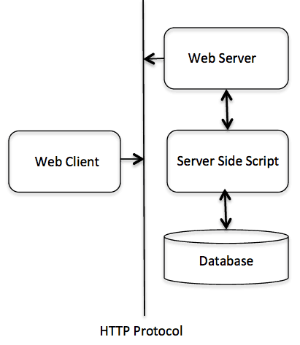

Webapp develop work scope
Server side script
Choose a programming language and framework.
Function: To dynamically interact with client side; Receive request, generate response.
Database
Choose appropriate database software.
Design data table structure; query / update data.
Python web development
Use python as server side script programming language.
Interaction with web server software using WSGI interface.
We use Django webapp frame
Design database table structure, use python database API to interaction with database.
We use Sqlite3
We will use Django as server side script programming framework.

Slide 3
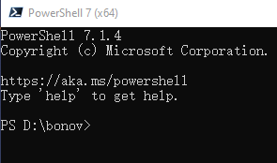
Install powershell
We need run a lots of things through command line. Windows command line or terminal is good enough.
But to make things easier, we suggest to install powershell from Microsoft. This is a cross-platform shell which has lots of function.
PowerShell/PowerShell: PowerShell for every system! (github.com)

Slide 4
pipenv
Why need virtual environment?
Make sure it is clear what is the environment requirements for the app developed.
The virtual environment files which produced can be used to for production deployment.
PS> py –m pip install pipenv
Pipenv basic workflow
For each project you develop, create a directory
use pipenv to install packaged needed. If want work with specific version, install with version exactly specified.
Use the virtual_env/scripts/activate.ps1, to activate and work in shell. (also can use `Pipenv shell` to work in command prompt for the project’s environment setup)
After finally finished development, use pipenv lock.
The pipfile.lock will be used to guide production deployment
PS> ni –Type Directory proj1
PS> cd proj1
PS> pipenv --python 3

Slide 5
Work in virtual env
Pipenv shell
It will activate the virtual_env in current directory.
But it will not change the prompt, it will set the $ENV:VIRTUAL_ENV
PS> pipenv shell
PS> $env:virtual_env
PS> pipenv install django
This last one $env:VIRTUAL_ENV will let you know which virtual environment currently in.
If you are confused when you open several powershell windows, you can know by using this.

Slide 6
Work in virtual env
%the virtual_env location%/Scripts/activate.ps1
It will activate the specified virtual_env.
Change the prompt (to have the (virtual_env name)) at the beginning
If you specify the virtual_env for your vscode, it will automatically run this when start a powershell terminal.
PS> %virtual_env location%/Scripts/activate.ps1
(proj1) PS> pipenv install django
(proj1) PS> $env:virtual_env
This last one $env:VIRTUAL_ENV and prompt will let you know which virtual environment currently in. $env:virtual_env value is different from last way entering the virtual env.
If you are confused when you open several powershell windows, you can know by using this.

Slide 7
The MVC design pattern
The Model-View-Controller (MVC) pattern, is based on the ‘loose coupling’ principle. The complete software was designed to have different module which they interact with each other with clearly defined interface.
Model (M) is a model of representation of your data.
View (V) is how to present your data to user.
Controller (C) is the flow and control between the model and the view. It uses program logic to decide what information if pulled from data and what to be sent to view to present.
Django term: MTV, Models-Templates-Views
M, define the data structure, abstraction of the data access
T, define how present, how something be displayed on screen
V, the business logic layer, like a bridge between M and V. It decide which model is needed and access it, also decide what result should be presented and defers data to appropriate template and send response to user.

Slide 8
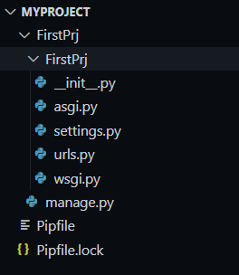
Create project
Under virtual environment shell, to do the following
This will give
Sun Django development web server with this cmd
Then can use your browser to view the default pages created by Django
(proj1) PS> django-admin startproject FirstPrj
(proj1) PS> py manage.py runserver
http://localhost:8000/

Slide 9
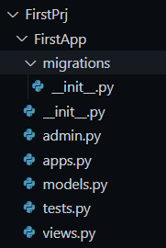
Create app
Then use following to create a webapp
This will give
(proj1) PS> cd FirstPrj
(proj1) PS> py manage.py startapp FirstApp

Slide 10
A tip when using VScode
Enter virtual_env first in your powershell.
Then use command to start code, it will properly parse all the imports of installed packages.
If you start vscode from windows10, then due to some environment variables issue, sometimes the vscode may not able to parse those packages installed in virtual_env, although to run it has no problem. (py manage.py runserver is ok in powershell).
PS> cd proj1
PS> %the virtual_env location%/Scripts/activate.ps1
(proj1) PS> code .

Slide 11
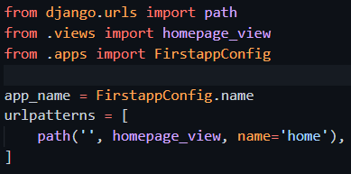
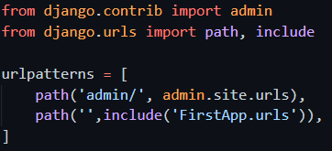
Config the URL
Create urls.py in FirstApp directory: (the following example is with powershell)
Add content to FirstApp/urls.py:
Modify FirstPrj/urls.py:
(proj1) PS> New-Item urls.py

Slide 12
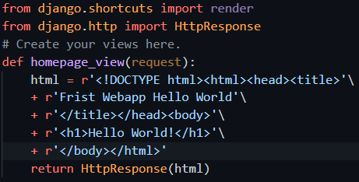
Generate the return content with view
Modify the FirstApp/views.py:
Add a new function homepage_view, which takes an HttpRequest object as arguments, return one HttpResponse with fixed html content.

Slide 13
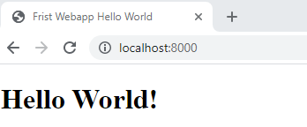
run the firstapp
Save all the changes and start the Django http server:
User browser, to open http://localhost:8000/
Django server give following information at console:
200 is the response status code, means success
114 is the length of returned content
(proj1) PS> py manage.py runserver

Slide 14
Django webapp development
Normal pattern involve work in mainly following 4 aspects:
urls: define incoming request url, and who should handle it.
views: define how to handle the url and return contents.
templates: define the HTML content structure to be used by view. Context been used as media to pass information from view to templates, so that templates can render to HTML file with dynamically changing data.
models: define database table. Views will query/update database.
Our FirstApp only involve urls and views. Nothing in templates and models.

Slide 15
Github, and git cli
What is github?
A famous content storage place. The base of it is a version control system. It is free to use.
You can upload and store your code.
You can cooperate with other person from a team with the version control function.
Register github account
You need an email address available to receive immidiately
After sign up, you will receive an email which gives you an activation code. Use that code to activate your account immediately and finish the sign up process.
Download git client
Git client software is a command line software, which can be used with all kinds of git repo. (not just github provide git repo publish service, there are also many others.)
Using command line is the most efficient way. But need some learning and practice to remember all those commands.
Download it and install.
https://github.com
Git - Downloads (git-scm.com)

Slide 16
Git repository
What is local repository?
In you project directory, you use git init to create local repository.
Local repository information is stored inside the .git directory inside your project directory
What is remote repository?
Remote repository is in the cloud (we use the storage provided by github)
After create correctly, you can fetch to get files from remote to local. You can push files from your local to remote.
Before can use, config your git cli to use your account just created:
PS> git config --global user.name “your name”
PS> git config --global user.email “your email address”

Slide 17
Create local repository
Use the following command:
PS> cd proj1
PS> git init
PS> git add –A
PS> git commit –m “My First Django App, Initial commit”
PS>

Slide 18
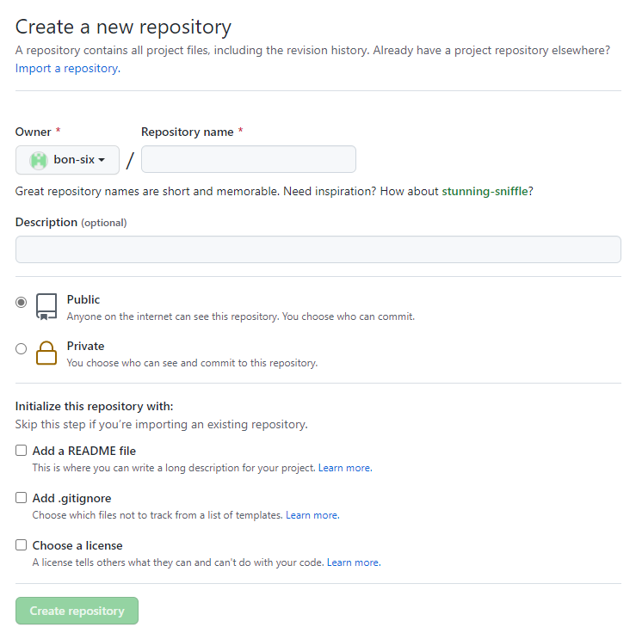
Create remote repository
Use browser visit github.com to create remote repo.
Give a repo name, and a description, then you can choose public or private, and uncheck all the checkbox, create one empty repo

Slide 19
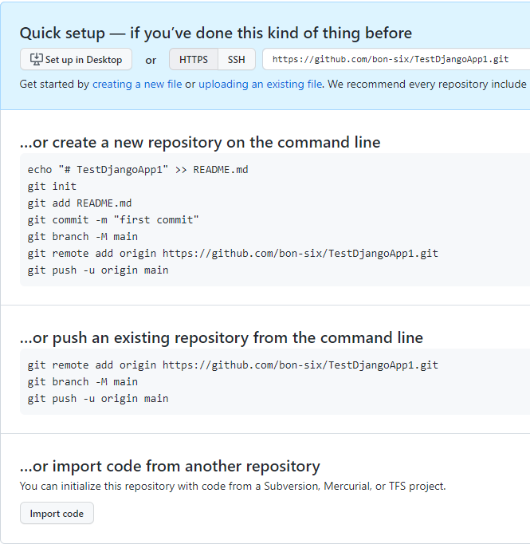
Push to remote repo
After created the second page information tells you how to add content to the just created repo.
The second option is what we needed. Type those command. Notice your repo name maybe different.
May need authenticate the account with a newly opened browser window when execute the command
PS> cd proj1
PS> git remote add origin XXXXXXXX
PS> git branch –M main
PS> git push –u origin main

Slide 20
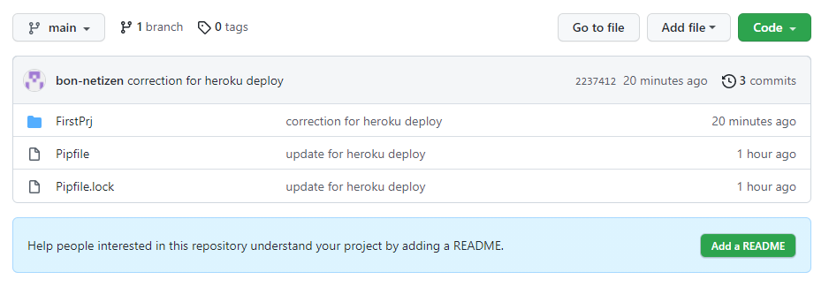
Now you can check your remote repo

Slide 21
Register a cloud account at heroku
Heroku account is free to register, and when only use one web DYNO server is also free (with limited time).
After sign a new account, Heroku will immediately send you a verification email. Check the email and click to verify.
After create password for your account, it will be activated.
Download Heroku cli software and install it.
https://devcenter.heroku.com/articles/heroku-cli

Slide 22

Prepare your app for deploy to heroku
Create one file: proj1/FirstPrj/Procfile
Add one line code to Procfile:
Update proj1/FirstPrj/FirstPrj/setting.py code, allow all hosts access.
Use pipenv shell to install gunicorn:
Copy the pipfile and pipfile.lock from proj1 to proj1/FirstPrj/.
PS> pipenv install gunicorn
PS> cp pip* ./FirstPrj

Slide 23
Prepare your app for deploy to heroku
Update your change to remote repo.
PS> cd proj1
PS> git status
PS> git add –A
PS> git commit –m “update for deploy to Heroku”
PS> git push –u origin main

Slide 24
Use Heroku cli to deploy app to cloud
Download and install Heroku cli application
At pipenv shell, can type Heroku login, to login your account just created. It will open a browser window to authenticate.
Replace with your own app name which given back by the create command
PS> heroku login
PS> heroku create
PS> heroku git:remote –a pacific-cove-21952
PS> heroku config:set DISABLE_COLLECTSTATIC=1
PS> git subtree push --prefix FirstPrj heroku main
PS> heroku ps:scale web=1
This will push the code to be deployed to Heroku. If any failure message need check again
Allow Heroku to run web site with one dyno

Slide 25
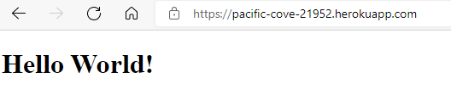
Now visit your cloud webpage

